Slide 1
Configure Arduino Micro for AC-DC Testing
Dr. Robert Sheehan Senior Technical Officer Dept. of Physics University College Cork 11 – 1 – 2021
Notes:
Buy a usb oscilloscope for people – balls to that, AM can sample
Ensure that we have spares of components to send out to people
Send all components at the same time

Slide 2
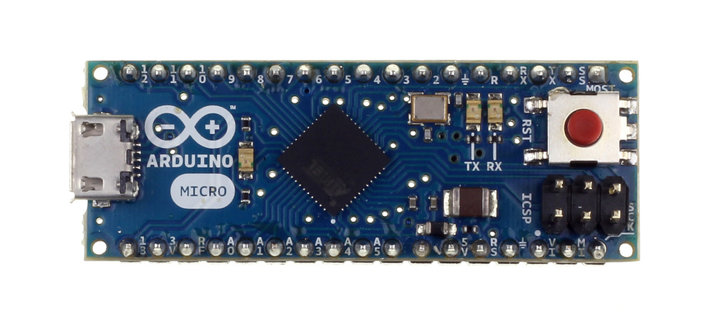
Arduino Micro
Arduino Micro (AM) is a development board based on the ATmega32u4 microcontroller.
Full details around the board’s technical specs can be obtained at the supplier website: https://ie.farnell.com/arduino/a000053/arduino-micro-dev-board/dp/2285194?ost=2285194#
Full details around the board’s technical specs can be obtained from the board data sheet (this one is in pdf format, therefore better): http://www.farnell.com/datasheets/1685581.pdf

Slide 3
Arduino Micro Power
Arduino Micro can be powered via the micro USB connection or with an external power supply.
External (non-USB) power can come either from a DC power supply or battery.
External power supply must be between 7V and 12V to ensure correct operation of board.
When board is powered correctly it is able to supply regulated 5V DC and 3.3V DC as well as acting as ground.
The DC supply is limited in current, max current output is less than 50 mA.

Slide 4
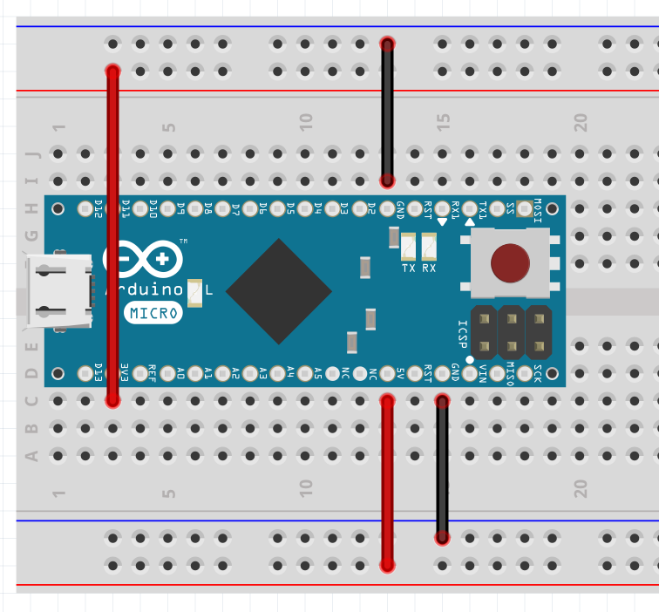
Arduino Micro Power
In this diagram ( created using Fritzing https://fritzing.org/ )
Two rails are connected to GND
One rail is connected to 3.3V DC supply
One rail is connected to 5.5V DC supply
It is assumed that board is powered through USB connected to a PC
GND
3.3V
GND
5V

Slide 5
Arduino Micro Pinout
As well as the GND, 3.3V and 5V power pins Arduino Micro has several pins that can be used for DC testing
Pins A0 – A5 are analog inputs
they can be used to read DC voltage in the range 0V to 5V
Voltage values outside the range [0, 5] will not be read
Pins D2 – D13 are digital outputs
they can be set to digital ON (5V) or digital OFF (0V)
Pins D4 – D6, D9, D10, D12, D13 are digital pulse width modulation (PWM) outputs
they can be used to generate a train of variable width pulses
PWM can be converted to quasi-analog DC signal in the range [0, 5]
Full pinout shown on next slide
Note that some pins have multiple functions (We’ll keep it simple for now. )

Slide 6
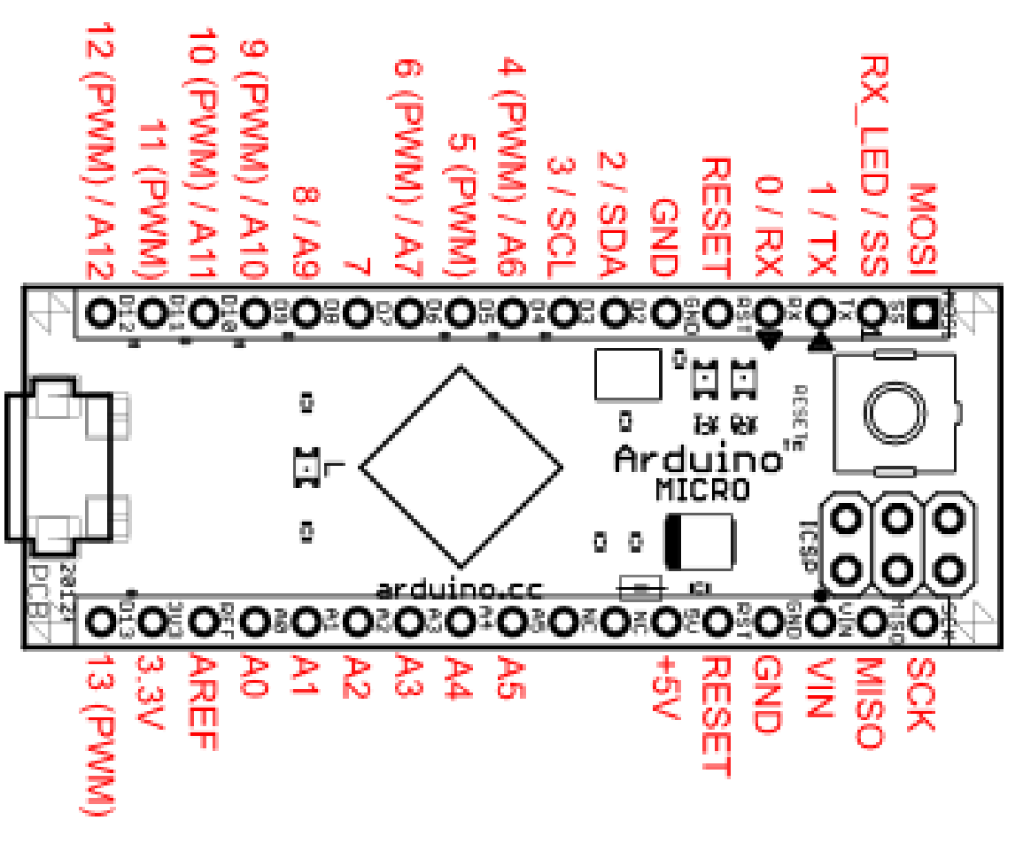
Arduino Micro Pinout
Digital Out
Analog In

Slide 7
Arduino Micro Programming
Arduino Micro must be programmed using a variant of the C programming language
Instructions for the board are written in a file called a sketch
The sketch is then uploaded to the board and the board executes the instructions
It is possible to interact with the board via text based Serial communications console after instructions are uploaded

Slide 8
Arduino Micro Programming
Arduino supplies an integrated development environment (IDE) that can be used to edit sketches and upload them to an Arduino board
Arduino IDE comes pre-packaged with a set of libraries written for Arduino boards
Arduino IDE can be obtained free of charge from https://www.arduino.cc/en/software
Arduino also have an online language reference library https://www.arduino.cc/reference/en/
Sketches and LabVIEW code enabling all testing required for PY2108 is available at https://github.com/rnsheehan/ArdForPY

Slide 9
Arduino Micro Programming
Useful links:
Sketches and LabVIEW code enabling all testing required for PY2108: https://github.com/rnsheehan/ArdForPY
Introduction to Arduino: https://learn.sparkfun.com/tutorials/what-is-an-arduino/all
Installing Arduino IDE: https://learn.sparkfun.com/tutorials/installing-arduino-ide
Installing an Arduino Library: https://learn.sparkfun.com/tutorials/installing-an-arduino-library
Installing Arduino Board Definitions: https://learn.sparkfun.com/tutorials/installing-board-definitions-in-the-arduino-ide

Slide 10
Arduino Micro and DC Characterisation
Configure Arduino Micro for DC Output
Circuit for Semiconductor Diode Characterisation
Circuit for npn BJT Characterisation

Slide 11
Arduino Micro PWM Output
Arduino Micro can be configured to supply Pulse Width Modulated (PWM) output
PWM outputs a train of pulses of variable duty cycle with period T = 0.002 s (f = 490 Hz)
By varying the pulse duty-cycle you vary the average value of the output voltage over each period
PWM is available on Pins D4 – D6, D9, D10, D12, D13
Notes:
Put in a picture of the PWM output here

Slide 12
Arduino Micro PWM Output
PWM
PWM
PWM

Slide 13
Arduino Micro DC Output
Arduino Micro can be configured to supply DC output
By applying an RC filter (R = 1 kΩ, C = 100 μF) to the PWM output you can convert the AC PWM signal to a quasi-DC signal
The level of the quasi-DC signal can be varied by changing the PWM duty cycle.
Duty Cycle | Bit Value | Average Voltage / V
0 | 0 | 0
25 | 64 | 1.243
50 | 127 | 2.45
75 | 191 | 3.7
100 | 255 | 5
Notes:
Add a slide that talks about how this is then controlled using software

Slide 14
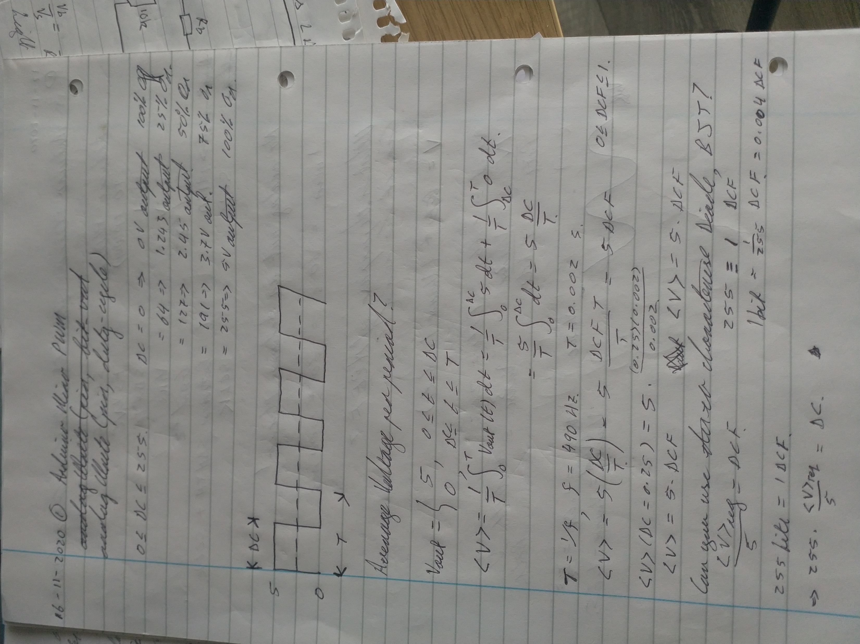
Arduino Micro DC Output
To obtain a desired average voltage of V_{d} from PWM choose PWM duty-cycle dc = int( 51 * V_{d} )
Notes:
Here is the calculation that proves the average of the PWM output equals the DC output

Slide 15
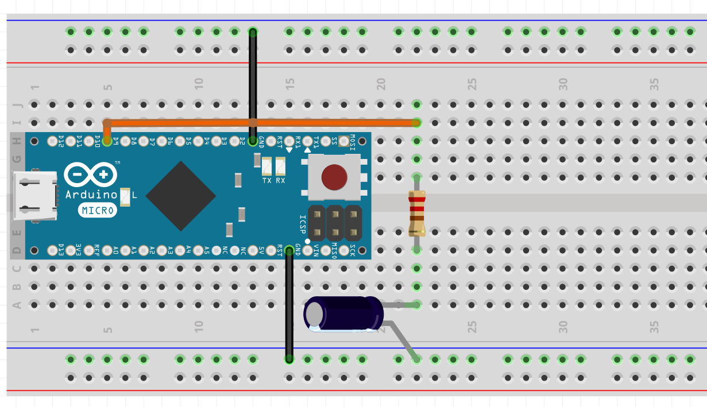
Arduino Micro DC Output 1 Ch
Pin 9 PWM
PWM can be converted to DC by application of LPF R = 1kΩ, C = 100 μF
PWM -> DC
Notes:
Add notes to this diagram so people know what the hell you’re talking about

Slide 16
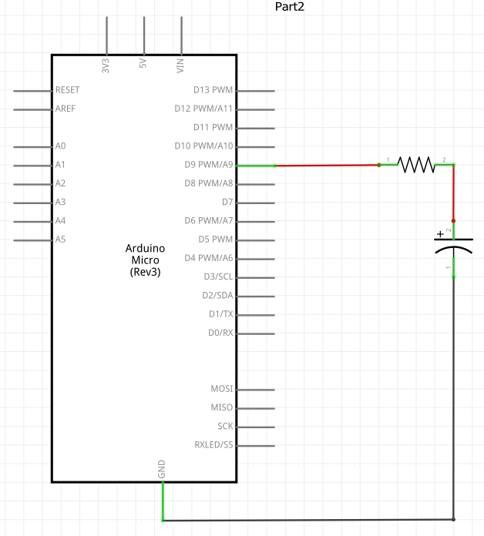
Arduino Micro DC Output 1 Ch
Pin 9 PWM
PWM -> DC
PWM can be converted to DC by application of LPF R = 1kΩ, C = 100 μF
Notes:
Add notes to this diagram so people know what the hell you’re talking about

Slide 17
Arduino Micro DC Output 1 Ch
Once the RC filter is in place the voltage level can be altered via Serial Interface to the board after sketch DCWriteRead.ino has been uploaded to the board
The sketch DCWriteRead.ino is available at https://github.com/rnsheehan/ArdForPY
The output voltage level is altered by calling the internal Arduino function analogWrite, see https://www.arduino.cc/reference/en/language/functions/analog-io/analogwrite/ for details
The arguments to the function are the pin being used and the duty-cycle value, see code snippet on next slide for details

Slide 18
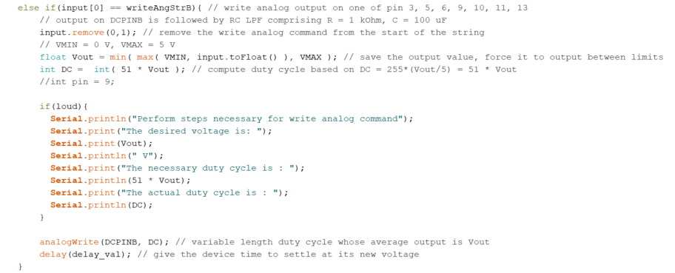
Arduino Micro DC Output 1 Ch
Sample input: b2.7 /* tell board to output 2.7V from channel B */
Compute duty-cycle to get desired average voltage In this case DC = 138
Change PWM duty-cycle

Slide 19
Arduino Micro DC Output 1 Ch
You can now vary the DC voltage being output by the board, however, you are limited in current to approx. 40 mA.
To overcome this limitation add a unity gain current amplifier (npn transistor) to your board.
In doing so you will amplify your current output by a factor β ~ 100
The transistor can be powered by connecting the 5V output of the Arduino Micro to the BJT collector terminal.
Current is amplified by connecting DC signal to the BJT base terminal
Amplified current can be put through DUT connected to BJT emitter terminal

Slide 20
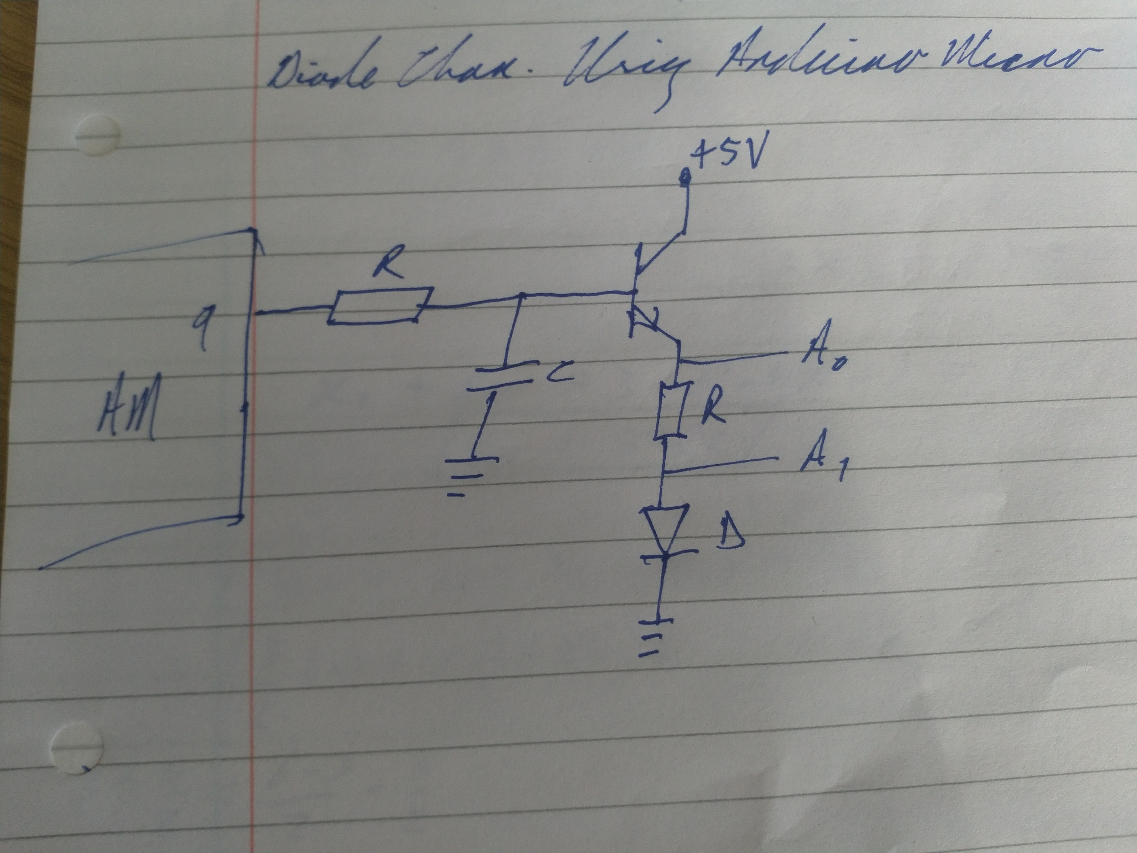
Arduino Micro Diode Characterisation
Consider characterisation of semiconductor diode
AM can generate DC signal 0 <= V_{in} <= 5V after
passing through RC LPF with R = 1kΩ, C = 100 μF
Current is amplified by passing DC signal through BJT
Actual current passing through diode for given input DC bias can be found by measuring bias across known resistor R ~ 10 Ω, I_{d} = A₀ – A₁ / R
Actual bias across diode can be measured directly using AM V_{d} = A₁
By sweeping the value of V_{in} and measuring I_{d} and V_{d} for each value the diode characteristic curve can be measured.
V_{in}

Slide 21
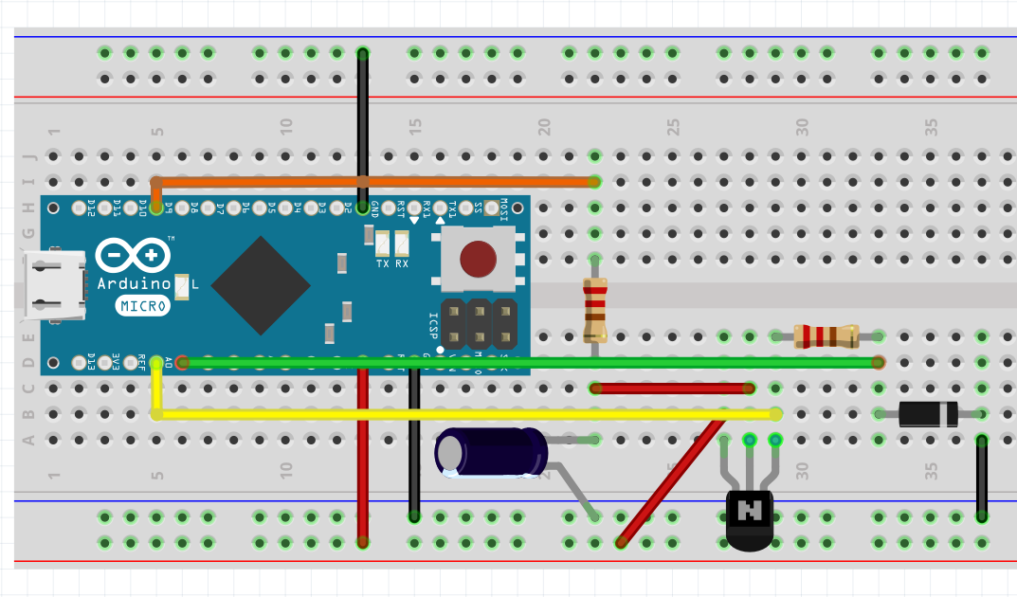
Arduino Micro Diode Characterisation
Layout of diode characterisation circuit on breadboard
Vin specified by DCWriteRead.ino
Command: a<vin> <vin> is some number in the range [0, 5]
A₀, A₁ measured by board
Command: l ( ``ell’’ for léigh, lis, lesen etc)
Pin 9 PWM
Vin
A₁
A₀
Gnd
+5V

Slide 22
Arduino Micro Diode Characterisation
Possible to implement DC sources on AM
+5V is supplied by AM, no external
power-supply needed
Current amplifiers required to ensure sufficient current is available.
Measurement of biases enabled through Analog Inputs A0 – A5 on board
Results as expected for R = 10 Ω and diode FR1001

Slide 23
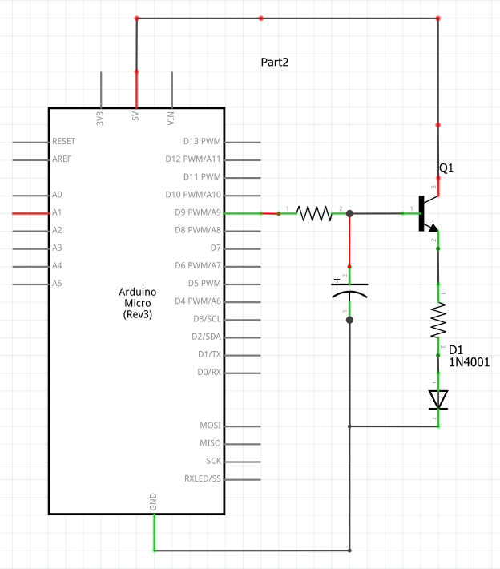
Arduino Micro Diode Characterisation
This is the schematic offered up by
Fritzing when I made the breadboard diagram.
Pin 9 PWM
PWM -> DC

Slide 24
Arduino Micro DC Output 2 Ch
Since there are multiple independent PWM channels you can have multiple independent DC sources
You just need to add RC LPF and BJT to each PWM output that you want
For PY2108 two DC sources is sufficient
In my implementation I have chosen pin 9 (labelled ``a’’ in the sketch) and pin 6 (labelled ``b’’ in the sketch)

Slide 25
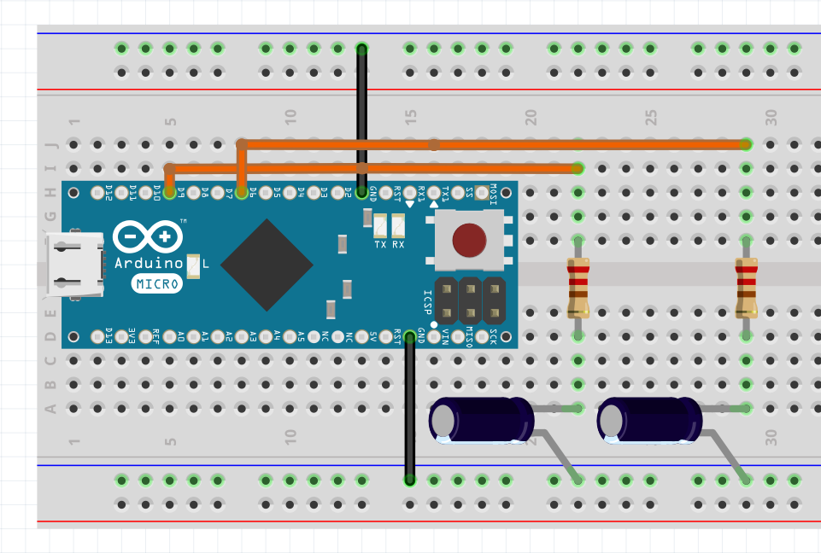
Arduino Micro DC Output 2 Ch
Pin 6 PWM
Independent DC output can be obtained on multiple PWM channels R = 1kΩ, C = 100 μF
For current amplification you will need BJT powered by +5V on each
Pin 9 PWM
PWM9 -> DC1
PWM6 -> DC2
GND

Slide 26
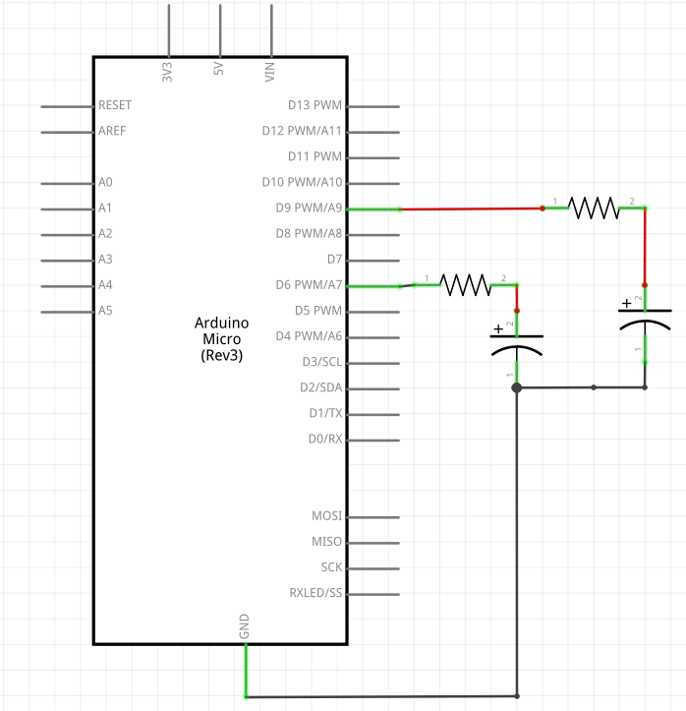
Arduino Micro DC Output 2 Ch
Pin 9 PWM
PWM9 -> DC1
Independent DC output can be obtained on multiple PWM channels R = 1kΩ, C = 100 μF
PWM6 -> DC2
Pin 6 PWM
GND

Slide 27
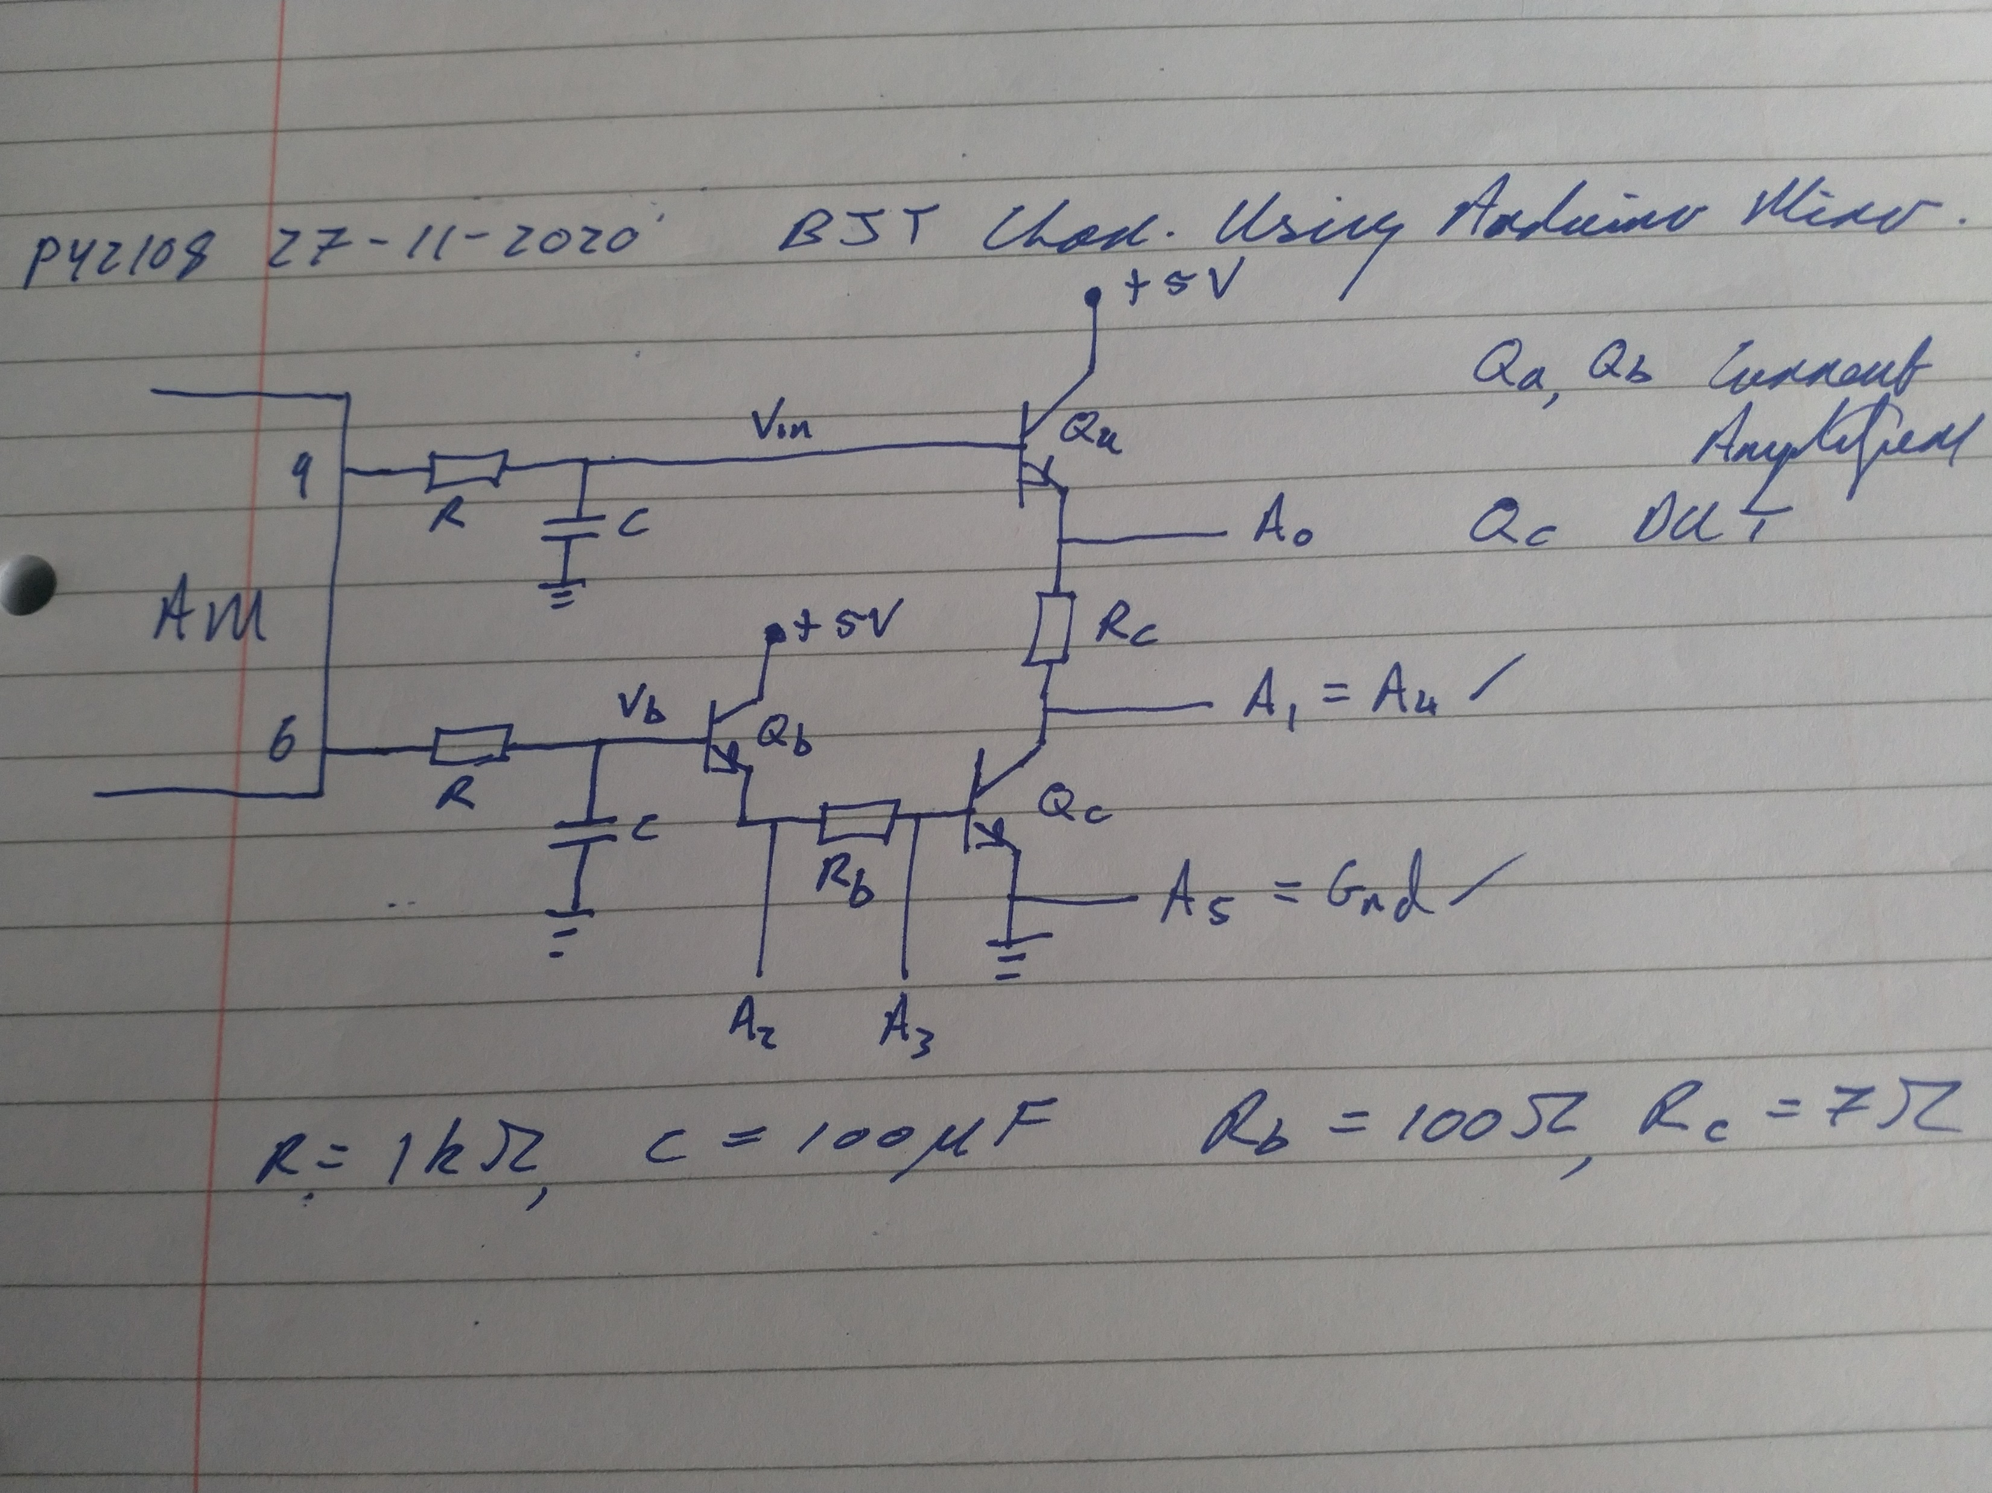
Arduino Micro BJT Characterisation
Consider characterisation of npn transistor Q_{c}
DC signals can be generated by channels a (PWM9) and b (PWM6). Current on those channels is amplified by UGA Q_{a}, Q_{b} each powered by AM +5V output
To obtain characteristic of Q_{c} choose R_{b}, R_{c} st R_{b} ~ 20 R_{c}
Apply a constant bias to base of Qc, i.e. fix V_{inb} to get constant current through R_{b} -> I_{b} = (A₂ – A₃) / R_{b}
Sweep bias at collector Qc, vary V_{ina} to get variable current through R_{c}, I_{c} = (A₀ – A₁) / R_{c}
Measure collector-emitter bias V_{ce} = A₁
Can then obtain plot I_{c} versus V_{ce} for different I_{b} values

Slide 28
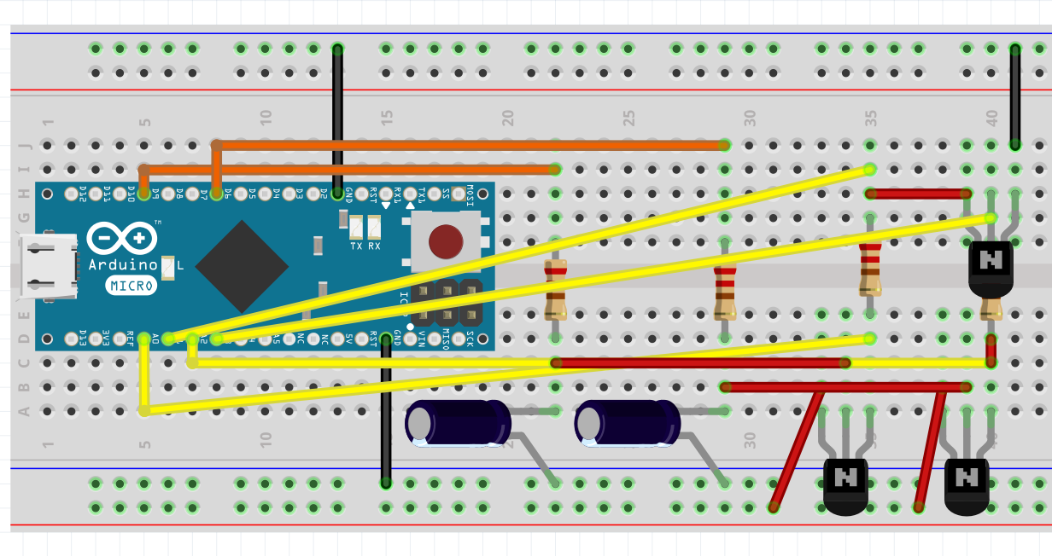
Arduino Micro BJT Characterisation
Layout of BJT characterisation circuit on breadboard
Vinb specified by DCWriteRead.ino
Command: b<vinb>
Vina specified by DCWriteRead.ino
Command: a<vina>
<vin*> is some number in the
range [0, 5]
A₀, A_{1,} A₂, A₃ measured by board
Command: l ( ``ell’’ for léigh, lis, lesen etc)
Pin 9 PWM
Pin 6 PWM
R_{c}
V_{ina}
V_{inb}
R_{b}
GND

Slide 29
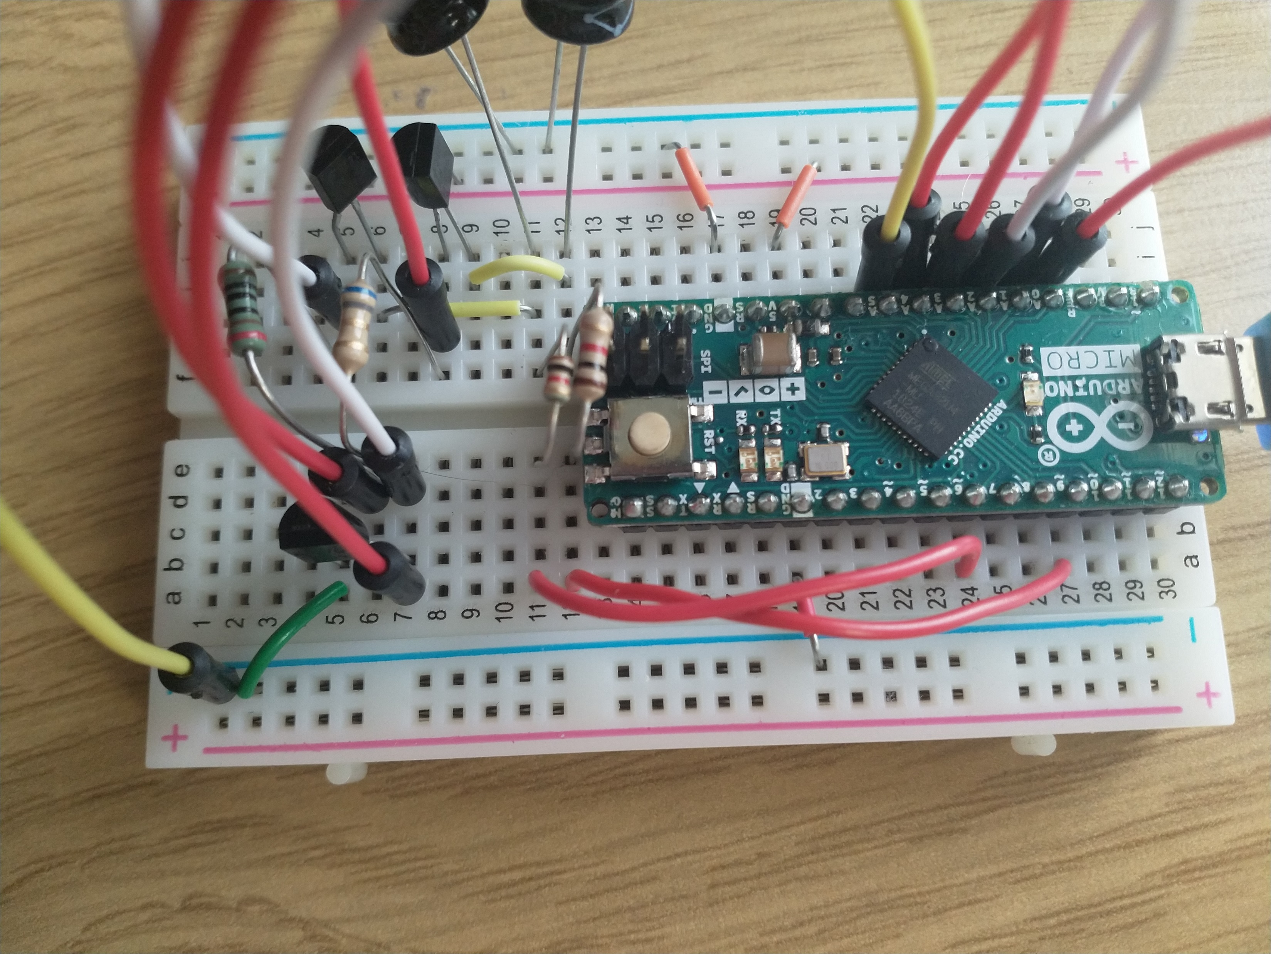
Arduino Micro BJT Characterisation
Possible to implement two DC sources on AM
Fix V_{b} while sweeping Vin
+5V is supplied by AM, no external
power-supply needed
Current amplifiers Q_{a}, Q_{b} required to ensure sufficient current is available. Measurement of biases enabled through Analog Inputs A₀ – A₅ on board

Slide 30
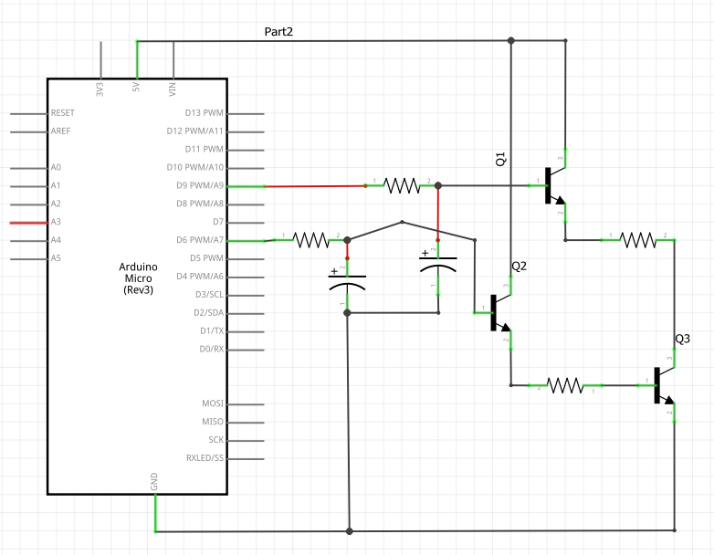
Arduino Micro BJT Characterisation
Pin 9 PWM
PWM9 -> DC1
Schematic of BJT board output by Fritzing
PWM6 -> DC2
Pin 6 PWM
GND

Slide 31
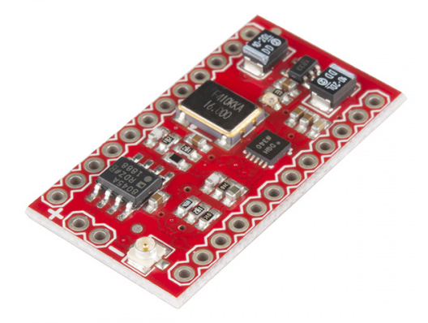
Arduino Micro and AC Characterisation
Configure Arduino Micro and SparkFun MiniGen for AC Output
Ensure Correct Operation of SparkFun MiniGen
LRC Filter Characterisation
OpAmp Characterisation

Slide 32
Arduino Micro AC Output
Arduino Micro cannot output an AC signal on its own
It can communicate with an external device that can generate a signal
The device we are using is called the SparkFun MiniGen
It outputs a 1 Vpp signal at DC offset of 1.65 V

Slide 33
Arduino Micro AC Output
Further details on the SparkFun MiniGen can be found here: https://learn.sparkfun.com/tutorials/minigen-hookup-guide
Details relating to SparkFun MiniGen software libraries can be found here: https://github.com/sparkfun/MiniGen

Slide 34
Arduino Micro AC Output
AM speaks with SFMG via communications protocol known as Serial Peripheral Interface (SPI), see https://en.wikipedia.org/wiki/Serial_Peripheral_Interface for details
Code exists to control operation of the SparkFun MiniGen, see https://github.com/rnsheehan/ArdForPY for details
Control over the SparkFun MiniGen requires SPI pins on Arduino Micro

Slide 35
Arduino Micro Pinout
Digital Out
Here are the usual digital and analog pins on the AM
Analog In

Slide 36
Arduino Micro Pinout
D10
MOSI
Here are the SPI pins on the AM
3.3V
Gnd
SCK

Slide 37
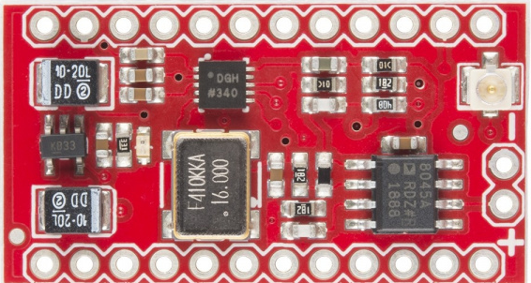
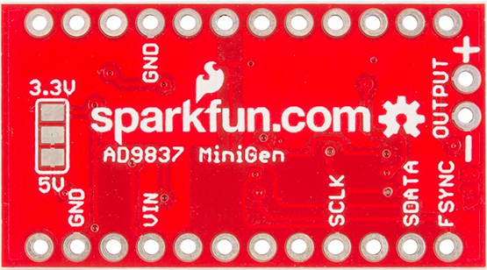
SparkFun MiniGen Connections
SparkFun MiniGen is supplied without headers Your friendly neighbourhood technical officer has soldered headers on for you There are 8 connections of interest 1. GND * 2 = Ground at Arduino Micro
2. VIN = Power Supply input from Arduino Micro 3.3V output
3. Output + = Signal output, 1 Vpp + Vin/2 DC offset
4. Output - = Connect to GND
5. SCLK = Serial Clock Input, connect to Arduino Micro SCK output
6. SDATA = Serial Data Input, connect to Arduino Micro MOSI output
7. FSYNC = Chip Select Input, connect to Arduino Micro D10
Ensure connections between Arduino Micro and SparkFun MiniGen are made correctly! Default output after uploading sketch SigGenWriteRead.ino will be 1 kHz sine wave

Slide 38
SparkFun MiniGen Connections
SparkFun MiniGen | Arduino Micro
Gnd | Gnd
Vin | 3.3V
Output- | Gnd
SCLK | SCK
SDATA | MOSI
FSYNC | D10
Output+ | Device Under Test
D10
MOSI
3.3V
Gnd
SCK
Check that device is working before making connections on breadboard using female-female connector cables All Gnd can be shorted together
Vin
Gnd
SCLK
SDATA
FSYNC
Gnd
Gnd
DUT / Osc

Slide 39
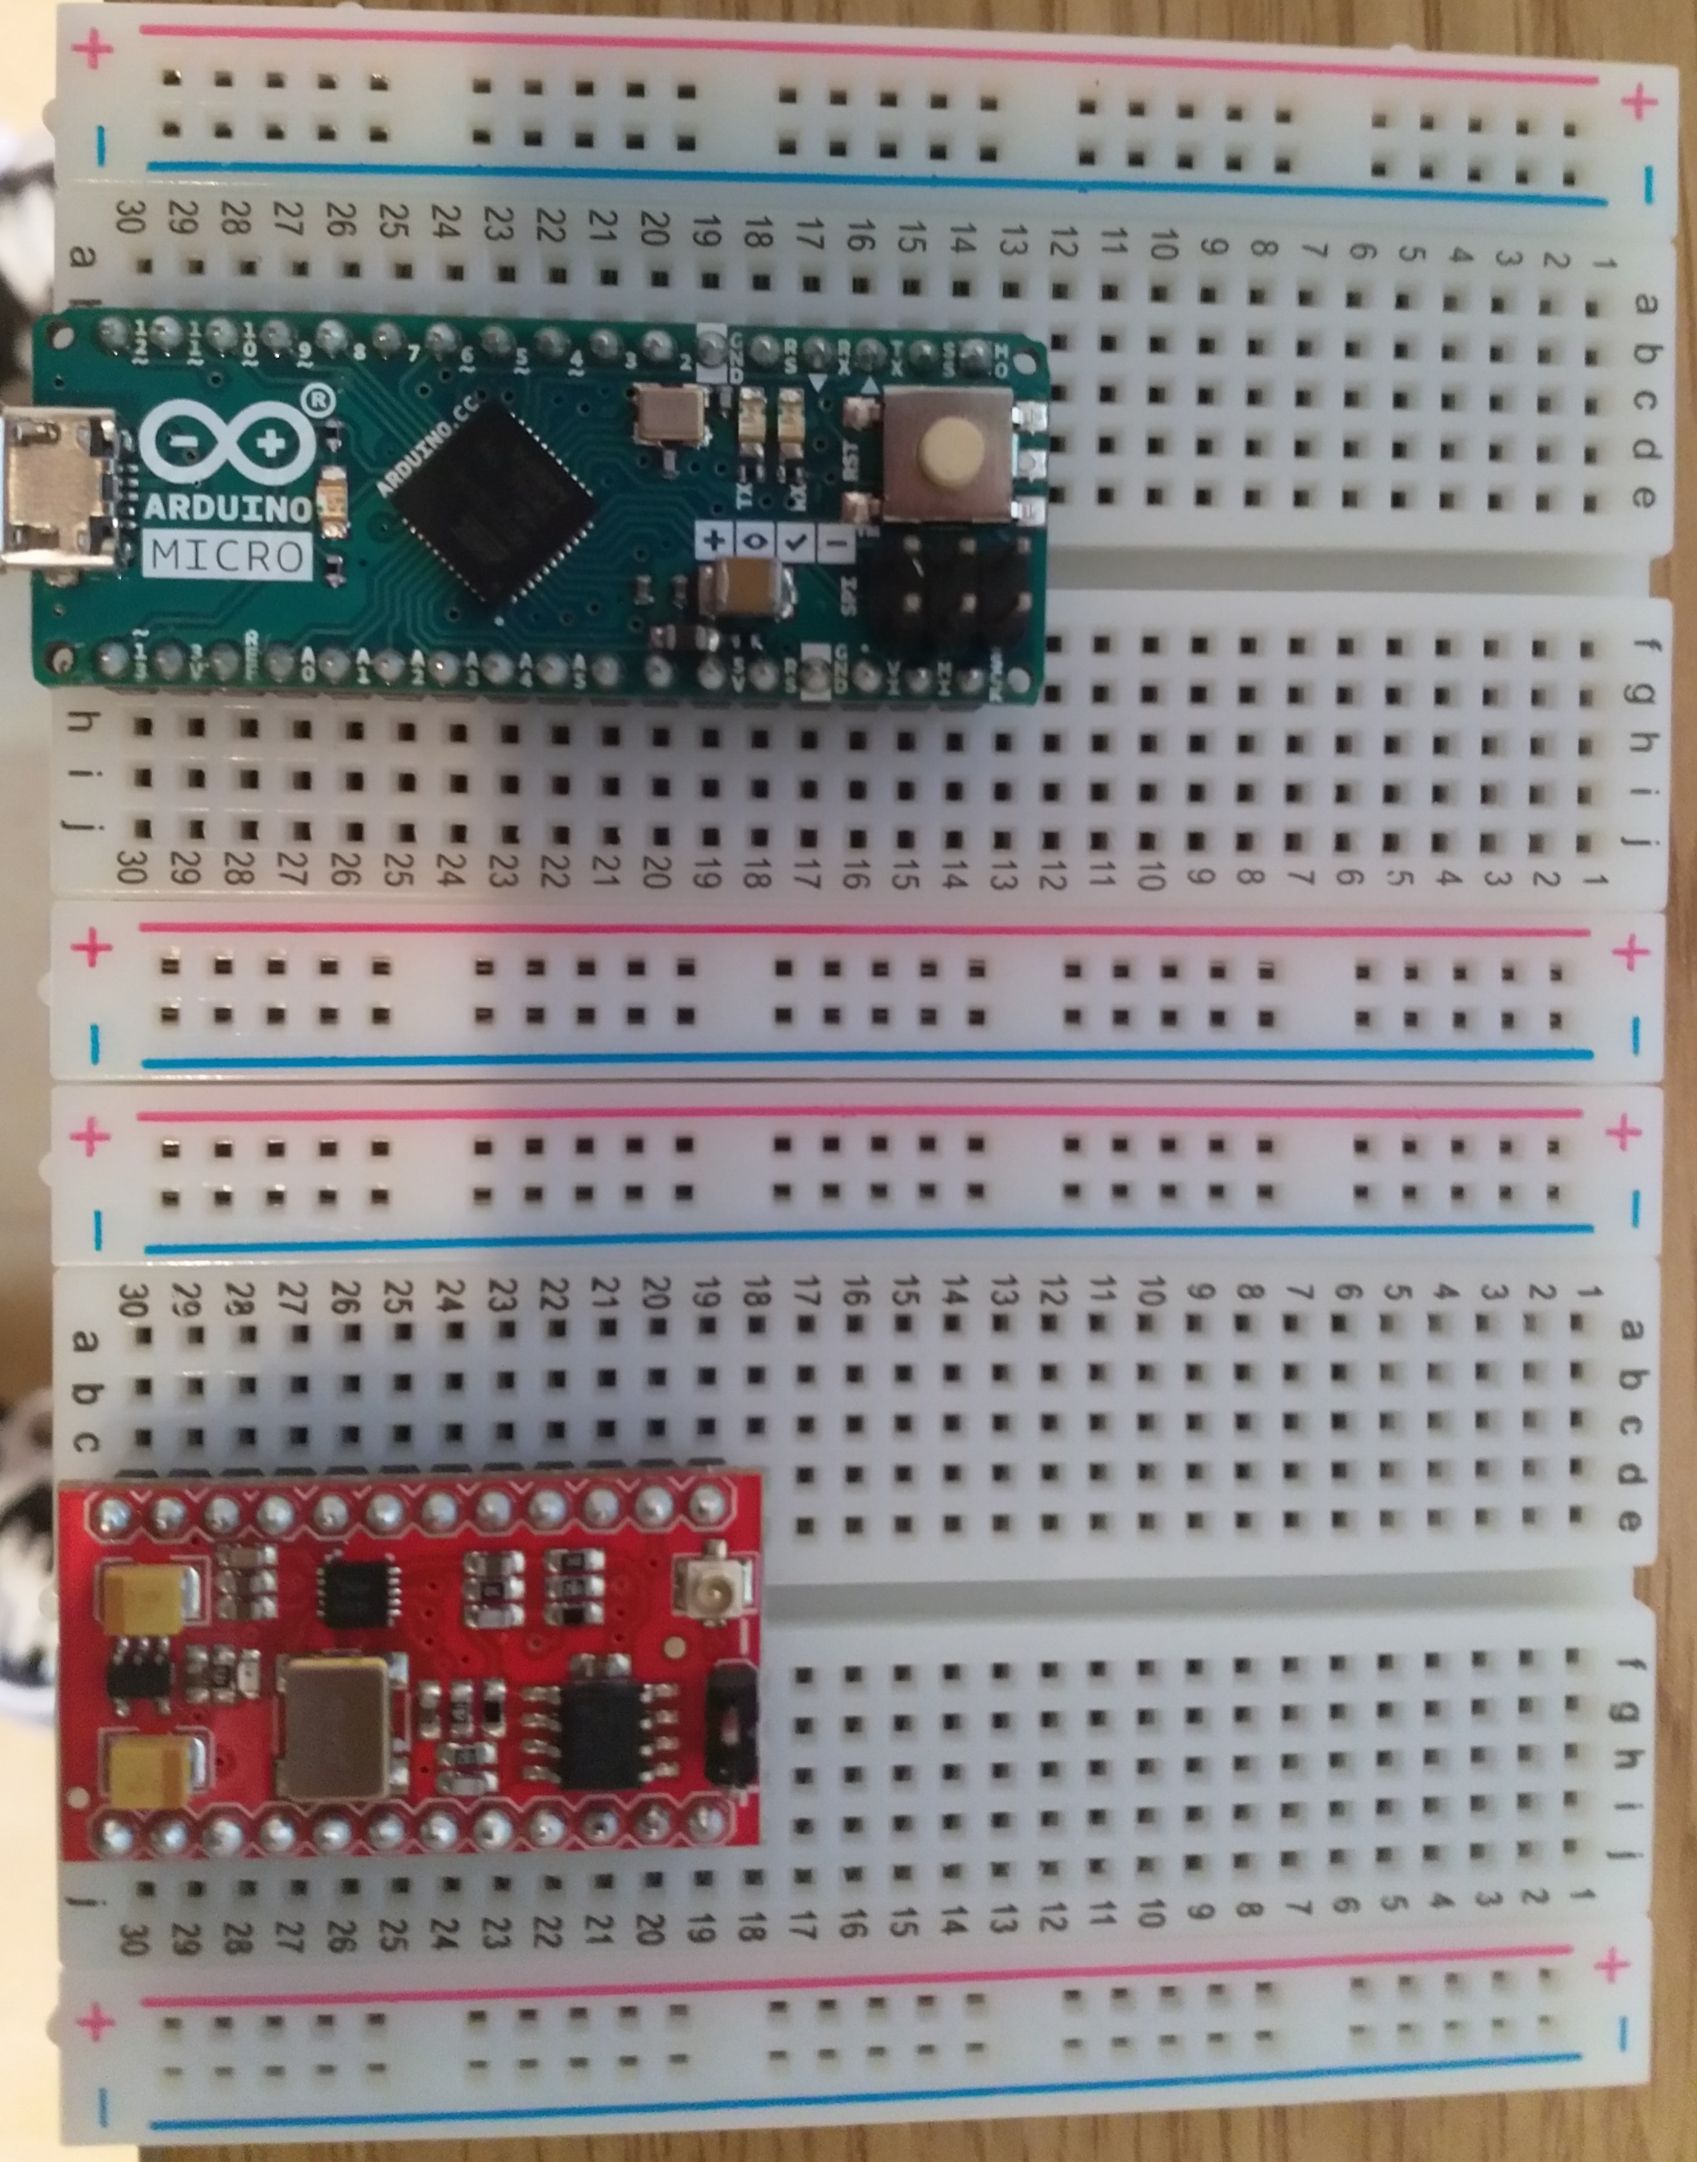
SparkFun MiniGen Connections
SparkFun MiniGen | Arduino Micro
Gnd | Gnd
Vin | 3.3V
Output- | Gnd
SCLK | SCK
SDATA | MOSI
FSYNC | D10
Output+ | Device Under Test
Gnd
Can set-up long term on two breadboards
DUT must be grounded to AM Gnd, same as SFMG
Measurements to take place through analog inputs A0 – A5
DUT

Slide 40
SparkFun MiniGen Sketch
The sketch SigGenWriteRead.ino can be used to change frequency being output by SFMG and also to measure max values on channels A₀ and A₁
The sketch is available at https://github.com/rnsheehan/ArdForPY
Interaction between the AM and the SFMG is managed by this sketch through Serial comms
Command w<freq> is used to alter frequency output by SFMG, e.g. w33500 tells the SFMG to output at frequency 33.5 kHz
Command r is used to read the max input values on A₀ and A₁

Slide 41
SparkFun MiniGen Operation Test
The easiest way to check if the SFMG is operating correctly is to connect output+ to an oscilloscope and observe the wave being generated by the board.
If everything is working correctly you should see a 1 Vpp sine wave at frequency 1 kHz
It should be possible to change the frequency of the wave using the Serial monitor and further confirm that everything is in good working order.
However, given that you probably don’t have access to an oscilloscope we must proceed differently.

Slide 42
SparkFun MiniGen Operation Test
I will see if I can implement code that enables accurate sampling at low frequency ~ 50 Hz, 100 Hz
To measure a sine wave of frequency f we must sample at frequency >= 2 f
I will start looking at the code and see what I can come up with.

Slide 43
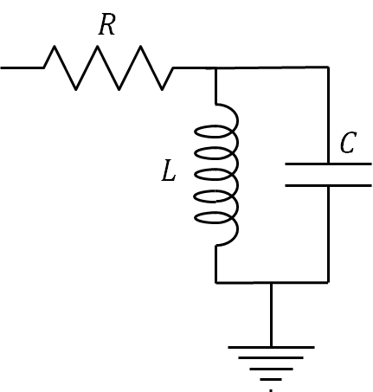
LRC Characterisation
Set up the RLC filter as usual
Connect input to A₀ and output to A₁
Recall the signal from SFMG is 1 Vpp sine wave offset by 1.65V
A₀, A₁ will see a signal, but AM is not able to accurately sample it
AM can only read signal [0, 5]
Add DC block to input in order to prevent DC offset affecting output
Measure response by using AM to measure max{A₀} – min{A₀} and max{A₁} – min{A₁}
A₁
A₀

Slide 44
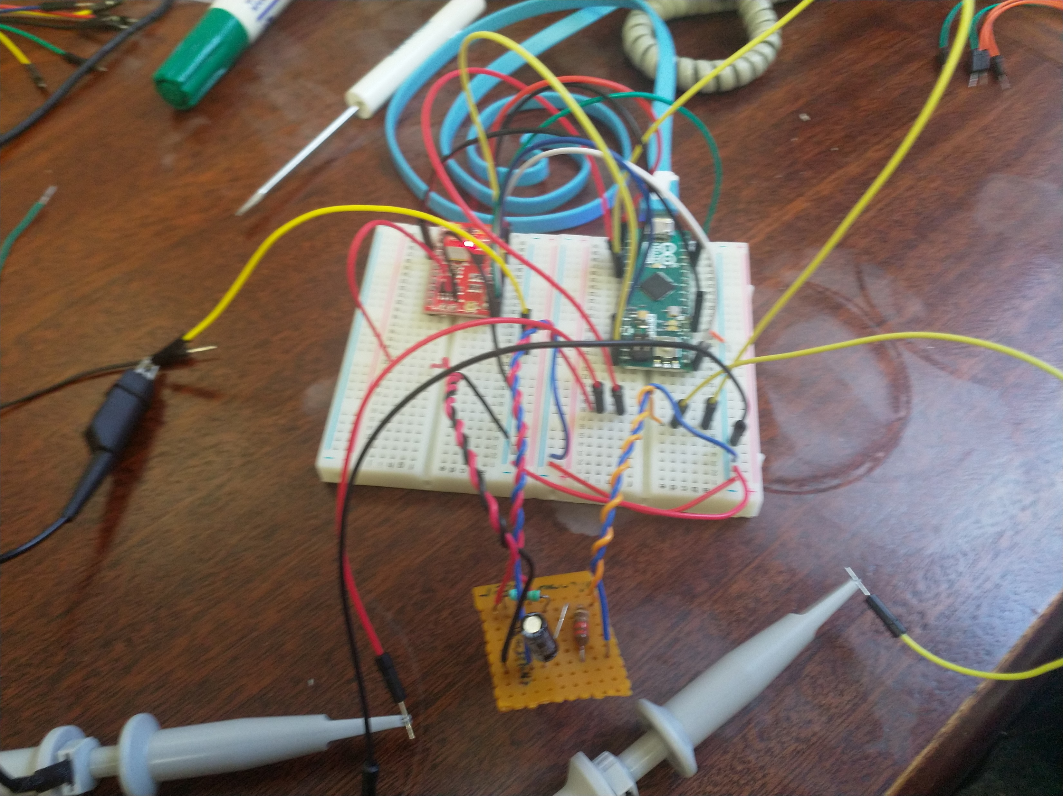
LRC Characterisation
Set up the RLC filter as usual
Connect input to A₀ and output to A₁
Recall the signal from SFMG is 1 Vpp sine wave offset by 1.65V
A₀, A₁ will see a signal, but AM is not able to accurately sample it
AM can only read signal [0, 5]
Add DC block to input in order to prevent DC offset affecting output
Measure response by using AM to measure max{A₀} – min{A₀} and max{A₁} – min{A₁}

Slide 45
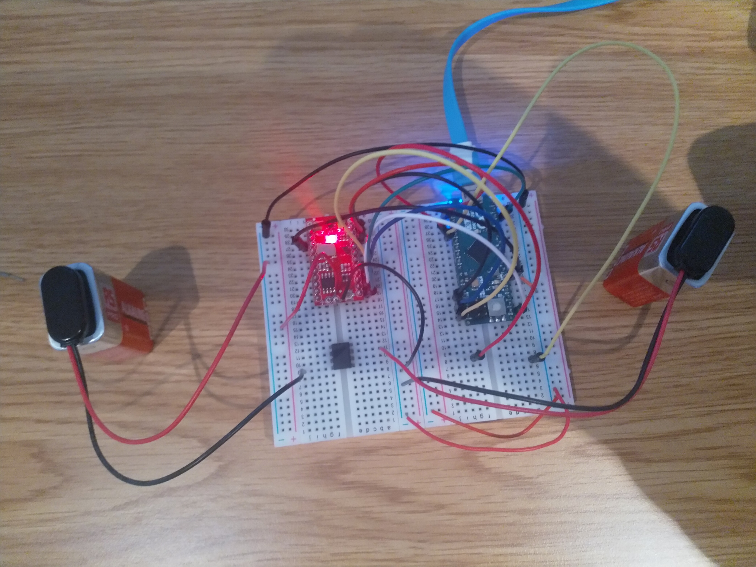
OpAmp Characterisation
Separate +/- 9V power supply required to ensure AM+SFMG can characterise op-amp circuit
Gnd
+9V
-9V

Slide 46
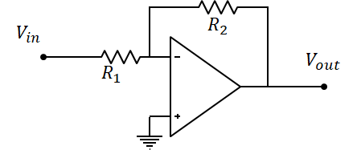
Inverting OpAmp Characterisation
Set up the inverting amplifier as usual
Connect input to A₀ and output to A₁
Recall the signal from SFMG is 1 Vpp sine wave offset by 1.65V
A0 will see a signal, but AM is not able to accurately sample it
A1 will see no signal because signal has been inverted
AM can only read signal [0, 5]
Add DC block to input in order to prevent DC offset affecting output
A₁
A₀

Slide 47
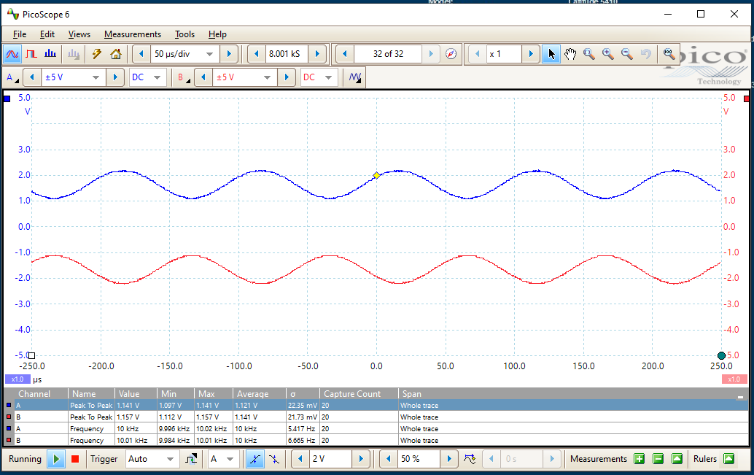
Inverting OpAmp Characterisation
No DC block at input
A₀ is in range [0, 5], AM can measure max and min values of signal
A₁ is in range [-5, 0], AM cannot see this signal will always return 0 V
A₁
A₀
Here R₁ = R₂ = 1 kΩ -> V_{out} = -V_{in}

Slide 48
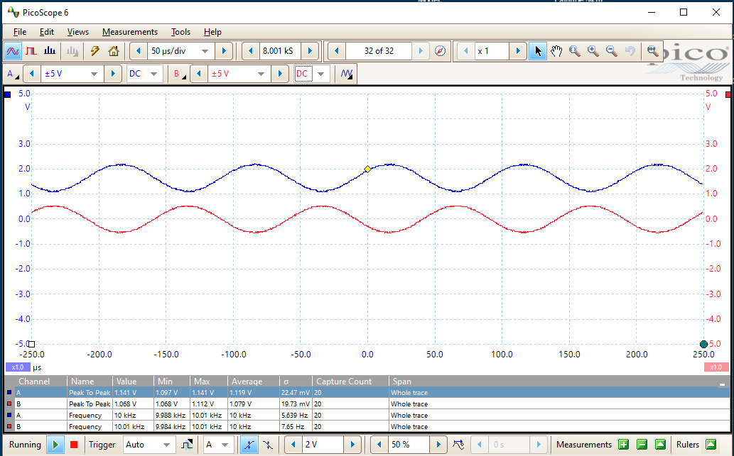
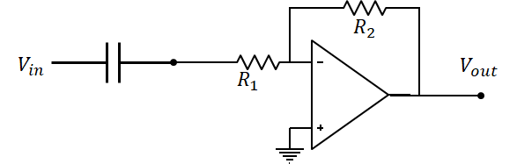
Inverting OpAmp Characterisation
If you add DC block (C = 1 μF) then you can test the Inverting amplifier
A₀ is in range [0, 5], AM can measure max and min values of signal
A₁ is in range [-1, 1], AM can see signal > 0
A₁
A₀
Here R₁ = R₂ = 1 kΩ -> V_{out} = -V_{in}

Slide 49
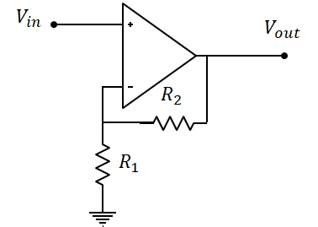
Non-Inverting OpAmp Characterisation
Set up the non-inverting amplifier as usual
Connect input to A₀ and output to A₁
Recall the signal from SFMG is 1 Vpp sine wave offset by 1.65V
A0 will see a signal, but AM is not able to accurately sample it
A1 will see also signal because signal has not been inverted
AM can only read signal [0, 5]
R vals must be chosen st V_{out}^{max} < 5 V
Use of DC block can enable wider range of R vals to obtain larger gain
A₁
A₀

Slide 50
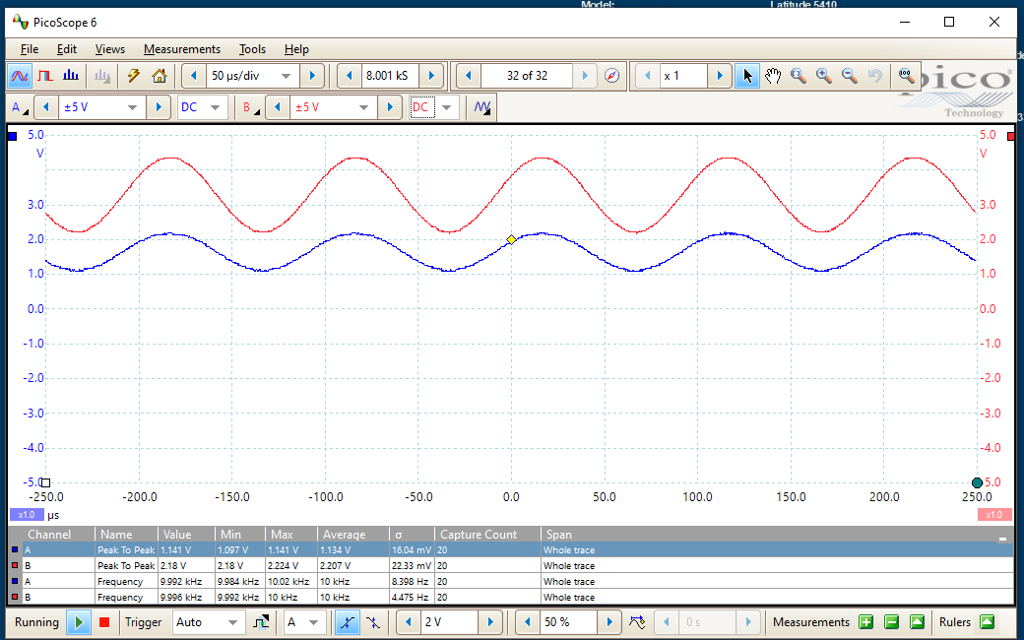
Non-Inverting OpAmp Characterisation
No DC block at input
A₀ A₁ are both in range [0, 5], AM can measure max and min values of signal
A₁
A₀
Here R₁ = R₂ = 1 kΩ -> V_{out} = 2V_{in}

Slide 51
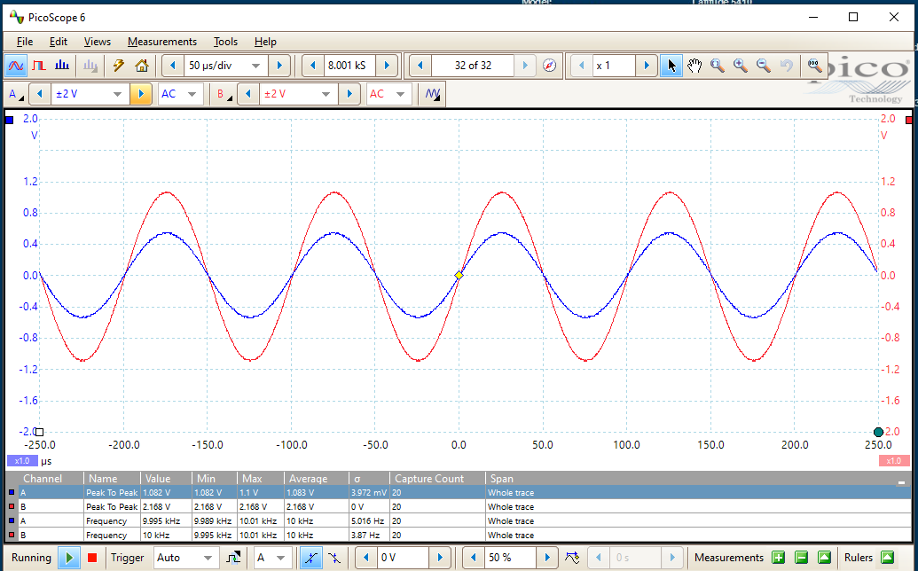
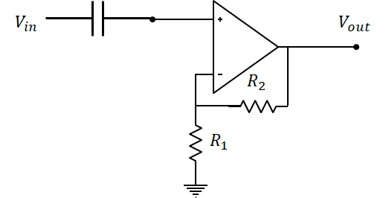
Non-Inverting OpAmp Characterisation
DC block at input allows wider choice of R vals to get higher gain
Can only measure on [0, 5] but could get higher amplification since no DC offset
A₁
A₀
Here R₁ = R₂ = 1 kΩ -> V_{out} = 2V_{in}

Slide 52

Arduino Micro DC Sketch

Slide 53
Arduino Micro DC Sketch
DCWriteRead.ino (https://github.com/rnsheehan/ArdForPY ) can be uploaded to the Arduino Micro to enable DC measurements
The sketch comprises four sections
preamble
setup
loop
function definitions

Slide 54
Arduino Micro DC Sketch
Preamble
Define constants used throughout the code
Define commands that tell Arduino Micro to perform some action
Constants and commands have been made consistent between DC and AC sketches
Commands are kept simple: write or read
To keep things simple I have defined 5 commands
AC read ‘r’
AC write ‘w’
DC read ‘l’
DC write from channel A ‘a’
DC write from channel B ‘b’
If anything other than these commands is input an error is thrown

Slide 55
Arduino Micro DC Sketch
Setup
Tell the board what each of the pin modes are for this sketch
Pinmode is a built-in command for the Arduino IDE
https://www.arduino.cc/reference/en/language/functions/digital-io/pinmode/
Set the baud rate for Serial comms
https://www.arduino.cc/reference/en/language/functions/communication/serial/begin/
It’s possible that baud rate can be optimised, but who has the time?

Slide 56
Arduino Micro DC Sketch
Loop
Main operating loop for the board
Loop is written such that it sits and waits for you to enter one of the commands before doing anything
In the case of DCWriteRead.ino there are only three valid inputs
readAngStr = l: print current measured voltages from Analog inputs A₀ – A₅
writeAngStrA = a<val>: output DC voltage of level <val> from channel A
E.g. a2.6: output 2.6V DC from channel A
writeAngStrB = b<val>: output DC voltage of level <val> from channel B
E.g. a1.234: output 1.234V DC from channel B
<val> should be a numeric string in the range [0,5], code will force it to either endpoint otherwise
Any other input will result in printing of ERR_STRING defined preamble
Arduino IDE has built-in string processing capability
https://www.arduino.cc/reference/en/language/variables/data-types/stringobject/

Slide 57
Arduino Micro DC Sketch
Function Definitions
Functions are defined after loop, no need for forward declaration
Only one function is used in DCWriteRead: analogVoltageRead
analogVoltageRead converts the bit-reading at the analog input pin to a voltage value
analogVoltageRead uses built-in analogRead function
https://www.arduino.cc/reference/en/language/functions/analog-io/analogread/
The other function defined in DCWriteRead is not called because is not applicable to the Arduino Micro, but is applicable for the ItsyBitsyM4.

Slide 58
Arduino Micro DC Sketch
Once the sketch has been uploaded the commands a<val>, b<val>, l can be used to control the device
One way is to open a Serial monitor that talks to the board, using Arduino IDE (Tools -> Serial Monitor) or Putty
The other is to open Serial monitor via LabVIEW
This has the advantage of enabling data parsing and storage ( the Arduino Micro is a Read-Only file system so it cannot create files )
AM_DC_Test.vi contains all the code needed to implement component characterisation
Write vi, Read vi, String Processing, Data Formatting etc
Diode and BJT characterisation loops have been implemented

Slide 59
Arduino Micro Programming
Arduino IDE can be obtained free of charge from https://www.arduino.cc/en/software
Arduino also have an online language reference library https://www.arduino.cc/reference/en/
Introduction to Arduino: https://learn.sparkfun.com/tutorials/what-is-an-arduino/all
Installing Arduino IDE: https://learn.sparkfun.com/tutorials/installing-arduino-ide
Installing an Arduino Library: https://learn.sparkfun.com/tutorials/installing-an-arduino-library
Installing Arduino Board Definitions: https://learn.sparkfun.com/tutorials/installing-board-definitions-in-the-arduino-ide

Slide 60
Arduino Micro AC Sketch

Slide 61
Arduino Micro AC Sketch
SigGenWriteRead.ino (https://github.com/rnsheehan/ArdForPY ) can be uploaded to the Arduino Micro to enable AC measurements in conjunction with the SparkFun MiniGen
The sketch comprises four sections
preamble
setup
loop
function definitions

Slide 62
Arduino Micro AC Sketch
Preamble
Define constants used throughout the code
Define commands that tell Arduino Micro to perform some action
Constants and commands have been made consistent between DC and AC sketches
Commands are kept simple: write or read
To keep things simple I have defined 5 commands
AC read ‘r’
AC write ‘w’
DC read ‘l’
DC write from channel A ‘a’
DC write from channel B ‘b’
If anything other than these commands is input an error is thrown

Slide 63
Arduino Micro AC Sketch
Setup
Set the baud rate for Serial comms
https://www.arduino.cc/reference/en/language/functions/communication/serial/begin/
It’s possible that baud rate can be optimised, but who has the time?
Tell the SparkFun MiniGen board what to do once it’s powered up
This set of commands resets the board to a known state
It requires all connections between SFMG and AM to be correct – REALLY IMPORTANT TO HAVE ALL CONNECTIONS CORRECT OTHERWISE SFMG WON’T WORK
If setup has executed correctly, and all connections are correct, output from SFMG will be a 1 kHz sine wave with amplitude 1 Vpp DC offset of Vin/2, Vin = 3.3 V

Slide 64
Arduino Micro AC Sketch
Loop
Main operating loop for the board
Loop is written such that it sits and waits for you to enter one of the commands before doing anything
In the case of SigGenWriteRead.ino there are only three valid inputs
readCmdStr = r: print current measured voltages from Analog inputs A₀, A₁
writeCmdStr = w<val>: change operating frequency of SFMG to <val> Hz
E.g. w33500: output 33.5 kHz sine wave
<val> should be a numeric string in the range [100, 3000000], code will force it to either endpoint otherwise
Any other input will result in printing of ERR_STRING defined preamble
Arduino IDE has built-in string processing capability
https://www.arduino.cc/reference/en/language/variables/data-types/stringobject/

Slide 65
Arduino Micro AC Sketch
Loop
When readCmdStr is input I currently tell the board to find the max voltage values on A₀ and A₁
I then subtract the DC offset value from A0 reading
It would probably be better practice to tell the board to return max{A₀}-min{A₀} and max{A₁} – min{A₁}
This would avoid any ambiguities that may arise in the use, or otherwise, of DC blocks that may occur
This is something that needs to be updated

Slide 66
Arduino Micro AC Sketch
Function Definitions
Functions are defined after loop, no need for forward declaration
Only one function is used in SigGenWriteRead: analogVoltageRead
analogVoltageRead converts the bit-reading at the analog input pin to a voltage value
analogVoltageRead uses built-in analogRead function
https://www.arduino.cc/reference/en/language/functions/analog-io/analogread/

Slide 67
Arduino Micro AC Sketch
Once the sketch has been uploaded the commands w<val>, r can be used to control the device
One way is to open a Serial monitor that talks to the board, using Arduino IDE (Tools -> Serial Monitor) or Putty
The other is to open Serial monitor via LabVIEW
This has the advantage of enabling data parsing and storage ( the Arduino Micro is a Read-Only file system so it cannot create files )
AM_Freq_Resp.vi contains all the code needed to implement frequency response characterisation
Write vi, Read vi, String Processing, Data Formatting etc
FR loop has been implemented, it is independent of the load attached to SFMG

Slide 68
Arduino Micro Programming
Arduino IDE can be obtained free of charge from https://www.arduino.cc/en/software
Arduino also have an online language reference library https://www.arduino.cc/reference/en/
Introduction to Arduino: https://learn.sparkfun.com/tutorials/what-is-an-arduino/all
Installing Arduino IDE: https://learn.sparkfun.com/tutorials/installing-arduino-ide
Installing an Arduino Library: https://learn.sparkfun.com/tutorials/installing-an-arduino-library
Installing Arduino Board Definitions: https://learn.sparkfun.com/tutorials/installing-board-definitions-in-the-arduino-ide

Slide 69
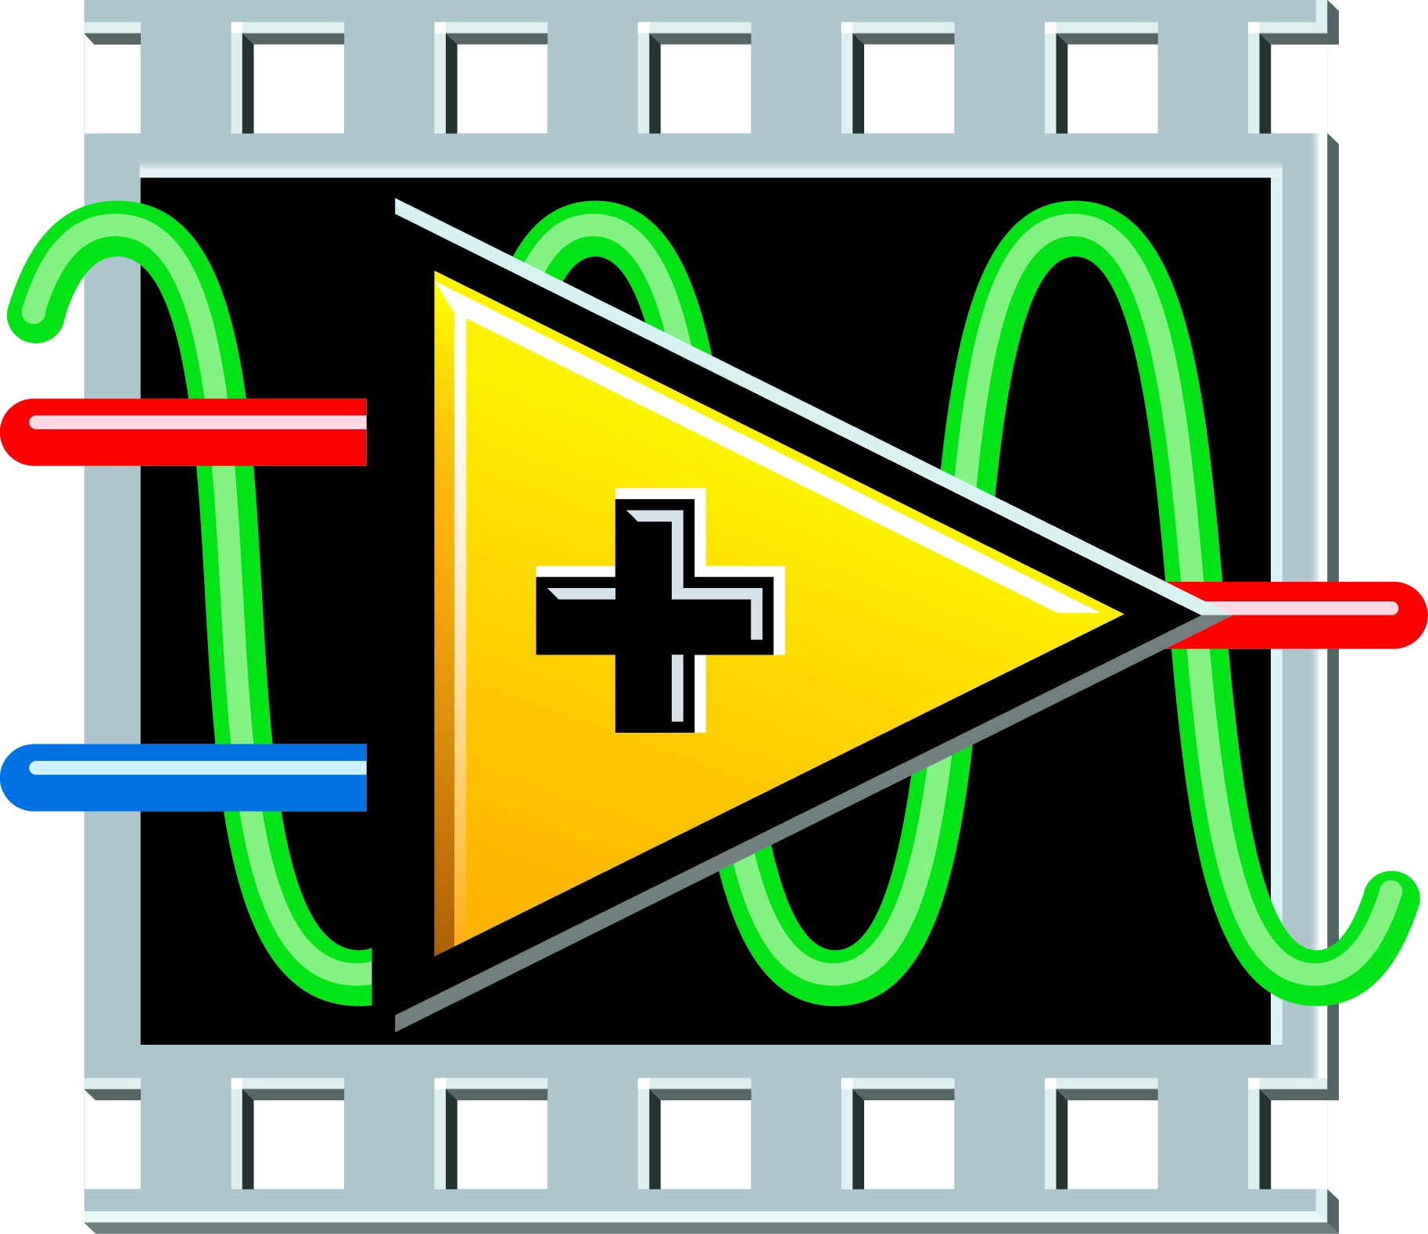
Test Automation with LabVIEW

Slide 70
Test Automation with LabVIEW
As far as the PC is concerned AM is an addressable serial port, this means we can use NI LabVIEW to talk to the AM board
Commands can be sent and data read using VISA write and read
LabVIEW has significant string processing capabilities built-in, this means that the actual code on the AM can be kept reasonably simple
LabVIEW code for performing automated characterisation is contained in https://github.com/rnsheehan/ArdForPY

Slide 71
Test Automation with LabVIEW
For DC tests see AM_DC_Test.vi located at https://github.com/rnsheehan/ArdForPY/tree/main/AM_DC_Test%20Folder/MicroControllers
For AC tests see AM_Freq_Resp.vi located at https://github.com/rnsheehan/ArdForPY/tree/main/AM_Freq_Resp%20Folder/MicroControllers
DC and AC tests have several VI in common, common vi are named starting with MuC_****
Context help should be available for each vi in any case

Slide 72
Acknowledgements
I would like to thank Ms. Lisa Faherty for her help in getting me started with the Arduino Micro, for bringing the SparkFun MiniGen to my attention and for helping me get the SparkFun MiniGen set up in the first place.

